Slide 1
Engine applications Knowledge sharing

Slide 2
Engine Applications
Power Generation : Ex: Power Generators(EPG)
Marine : Engines are used for two purposes
a) Primary :For propulsion(I,e movement of ship)
b)Auxillary : For generating power for usage on ship
Locomotives : Engines which are used in Trains
Industrial applications : EX : RIGS( Drilling machines Used in mining), Shovels(large machines used for moving mined materials)
Machines :
On Highway applications : Ex : On Highway trucks, Motor Graders etc
Off Highway applications : Ex: Off Highway Trucks(Large mining trucks)

Slide 3
Basic components of Automotive System
Power Train System:
1. Power Generation :
Responsible for generation of power( Engine)
2. Power Transmission :
Responsible for transferring the power generated by Engine to the wheels of the vehicle(Gear/Transmission, clutch etc )

Slide 4
Basic components of Automotive system
B. Chassis System
Suspension & shock absorbers
Used for reducing jerks & provide comfort
Braking
Used for regulating the vehicle speed
Utility
Used for achieving the functionality of the vehicle Ex: Bucket on Hexcavator , Bucket on trucks etc
4. Steering
Used for controlling the direction of vehicle movement

Slide 5
Basic components of Automobile system
C. Telematics & Infotainment
Infotainment:
Provides driver with the information of the vehicle like speed, fuel level etc and also in few cases entertainment systems like DVD players , radio etc EX: Digital speedometer , digital fuel indicators etc
Telematics :
Provides with the capability of remotely monitoring the vehicle’s usage efficiency by collecting and transmitting the information like fuel burnt, engine operating hours, device location through GPS, idle time etc.

Slide 6
Need for Electronic control modules for Engines
Fast Response with Engine efficiency optimization
Machine Integration
Meeting Emission standards
Reduce Engine wear and tear

Slide 7
Example of ECM network
Chassis
Xsmn
Park brake ,keyswitch
J1939
CDL
Engine speed
Engine operating hours
Engine
VIMS

Slide 8
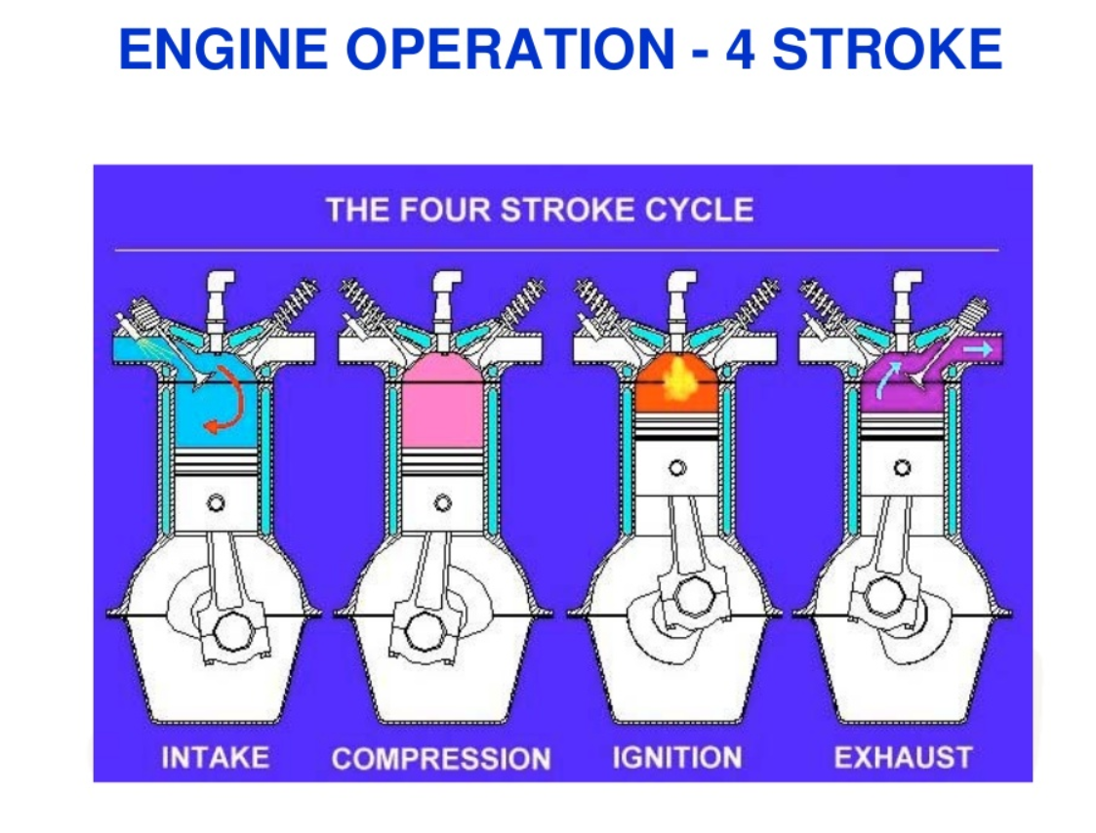

Slide 9
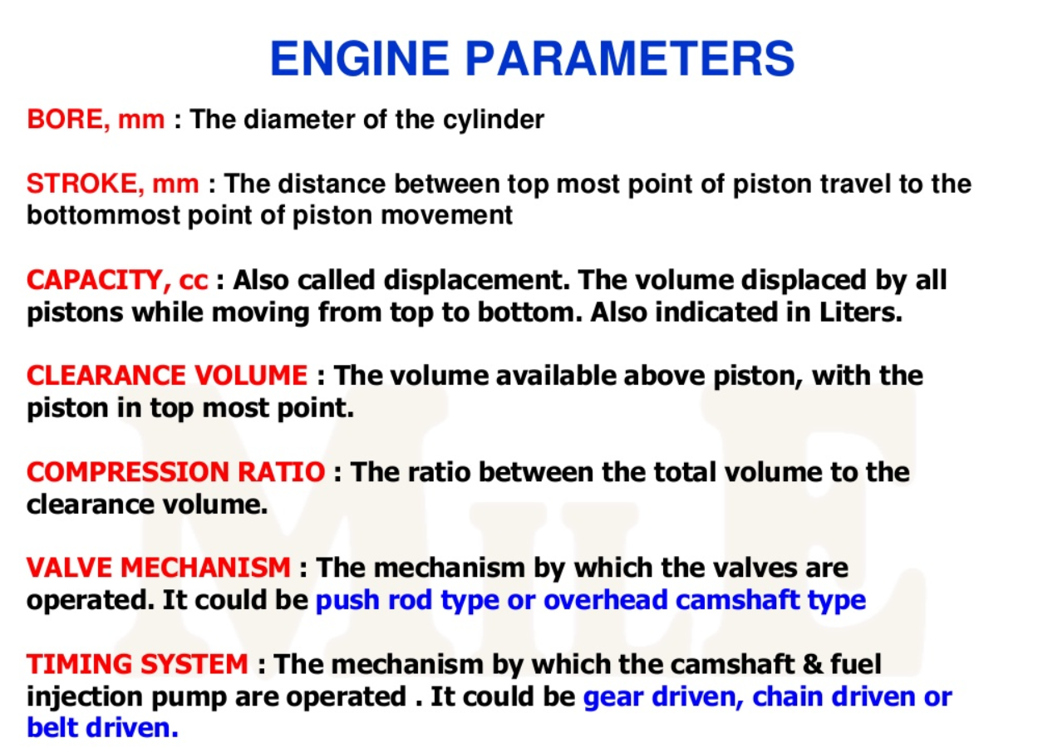

Slide 10
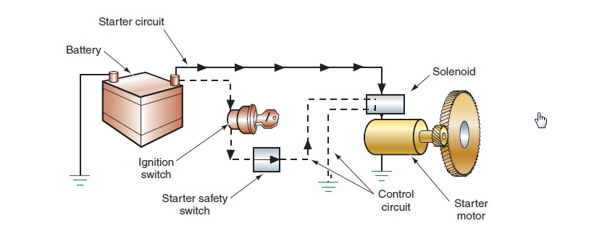

Slide 11
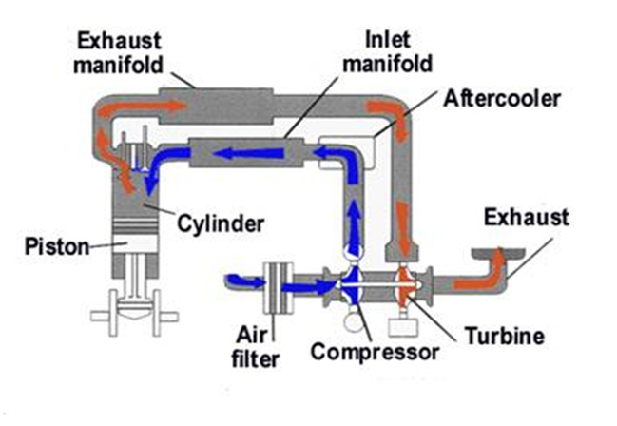
Air Intake system in Engine
Intake Manifold Air Pressure & Temperature sensors
Exhaust Temperature sensor
Compressor Inlet Pressure Sensor

Slide 12
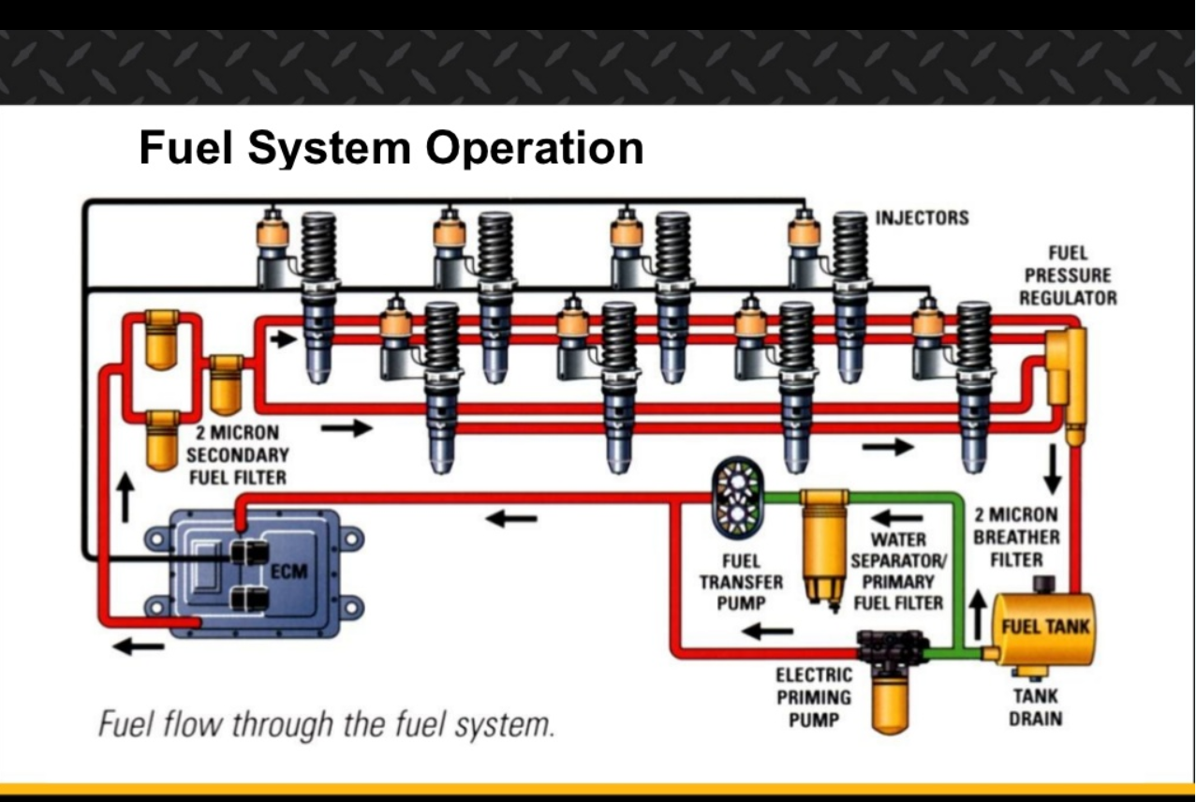
Filtered fuel Pressure sensor & Fuel Temp sensor
Unfiltered fuel pressure sensor

Slide 13
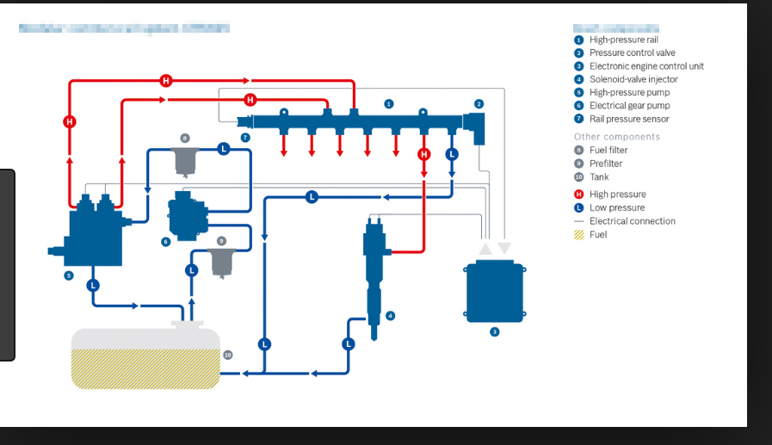
Fuel system in Engine
Filtered fuel pressure sensor & Fuel Temperature sensor
Unfiltered fuel pressure sensor
Fuel/Water level sensor

Slide 14
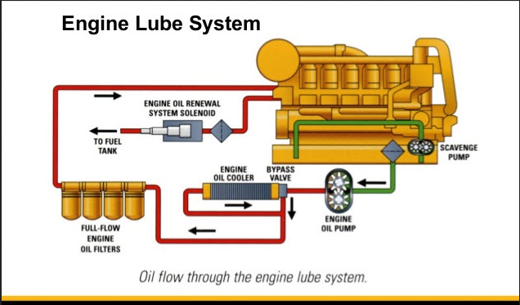
Pre-Lube Pump
Filtered oil pressure sensor
Engine Oil Temperature sensor
Unfiltered Engine oil Pressure Sensor

Slide 15
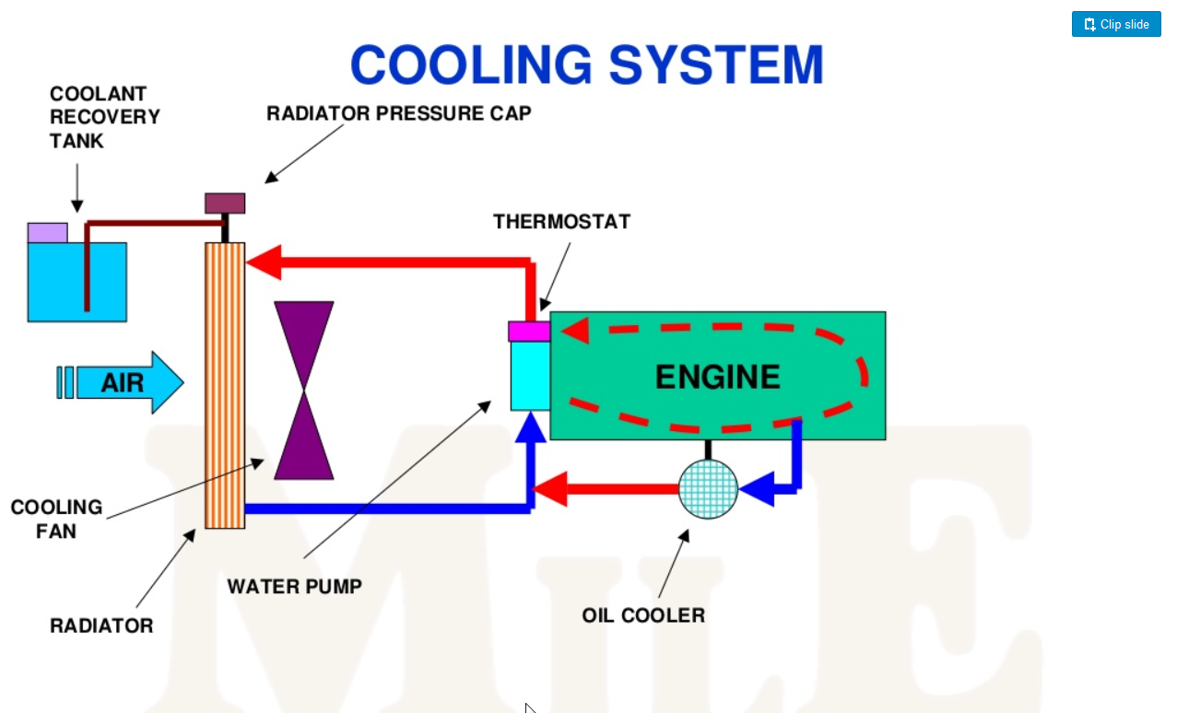
Coolant Temperature sensor

Slide 16
Engine features –few examples
Desired Engine speed/Engine Speed controlling features
Request from Throttle
2) Engine speed elevation during cold start
3) Cruise Control
4) Request from other machinery in the vehicle
Ex: Lifting more debris using the bucket in hexcavator

Slide 17
Engine features –few examples
Fluid level sensing in Engines
Fuel Level sensing
Oil Level sensing
Coolant level sensing

Slide 18
Engine features – few examples
Events/Diagnostics reporting due to system failures
Oil filter clogging
Fuel filter clogging
Air filter clogging
Low Engine oil Pressure

Slide 19
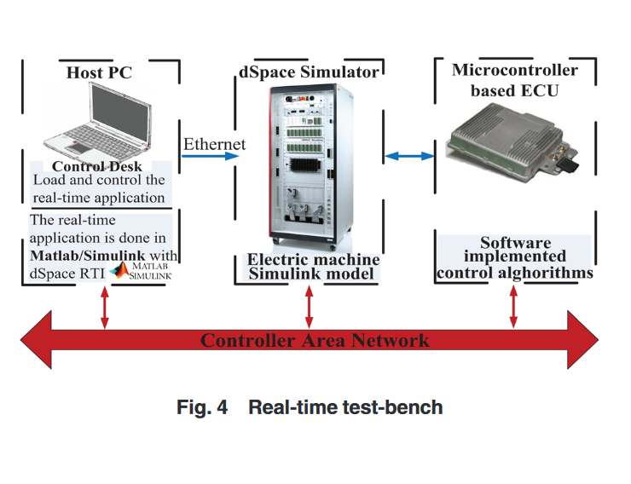

Slide 20
